Slide 1
STIs among people who use drugs
Adam Bourne
Associate Professor
Australian Research Centre in Sex, Health & Society
a.bourne@Latrobe.edu.au

Slide 2
Declaration
Speaker Name | Statement
Adam Bourne | Within the past 3 years I have received funding from ViiV Healthcare for attendance at expert advisory meetings and Gilead Sciences for training of healthcare workers with respect of drug use.
Date : | July 2018

Slide 3
Clusters of research
HIV and Hep C among people who inject drugs
HIV and STIs among gay, bisexual and other MSM
Other STIs among people who use drugs

Slide 4
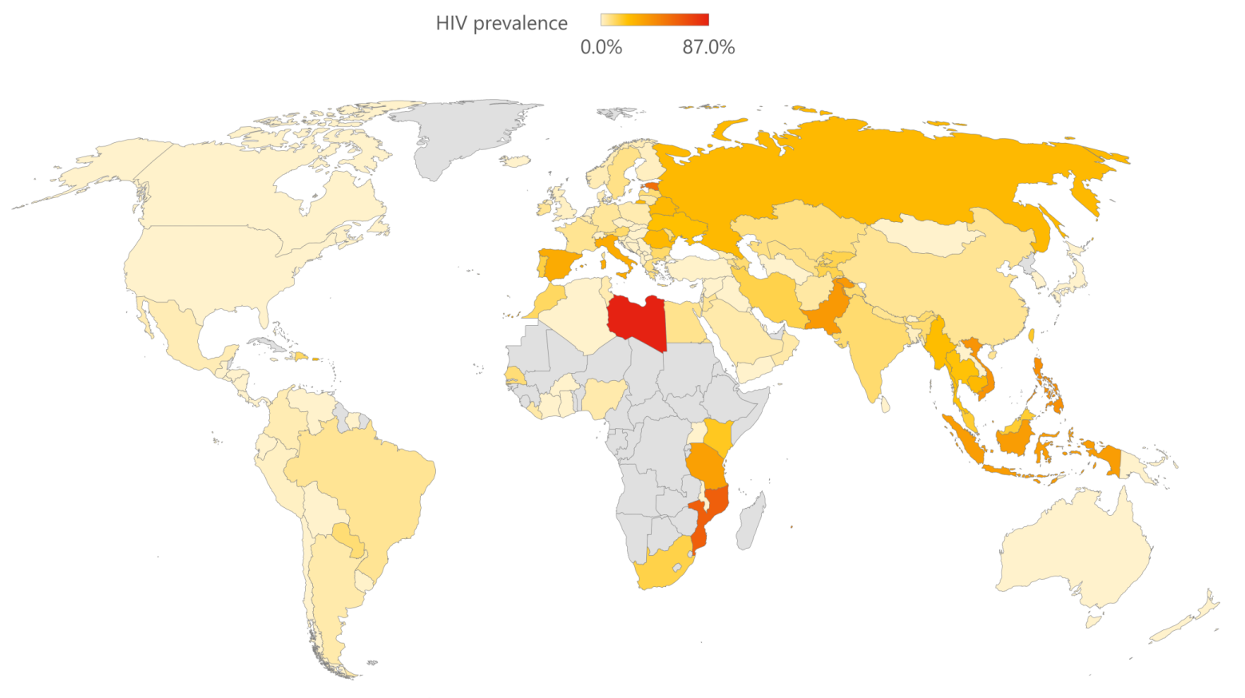
HIV prevalence amongst people who inject drugs
Projection: Robinson
Data from: Stone, K (2016) The Global State of Harm Reduction. Harm Reduction International

Slide 5
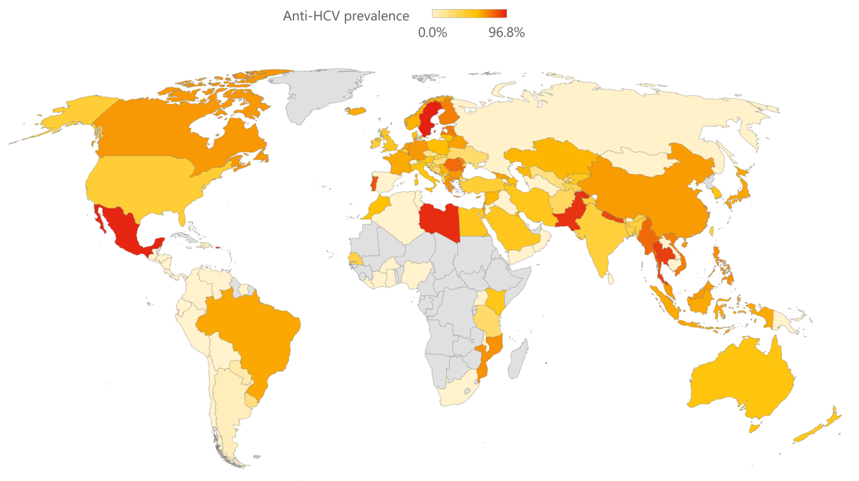
Hepatitis C prevalence amongst people who inject drugs
Projection: Robinson
Data from: Stone, K (2016) The Global State of Harm Reduction. Harm Reduction International

Slide 6
Epidemiology: Other STIs
Mainly convenience samples where HIV was main focus
Little routine surveillance of STIs (other than HIV/Hep C) among people who use drugs generally
Recent STI diagnosis common biomarker of imminent HIV infection
Significant heterogeneity within drug using populations
(Celentano et al, 2008; Lejuez et al, 2005; Khan et al, 2013)

Slide 7
Epidemiology: Other STIs
Research generally indicates high risk sexual behaviour, and (usually) high rates of STIs for people who use drugs
South Africa: 25% last year; Cambodia: 10.8% last 6 months; Kenya: 4.2% within study
Review of people who inject drugs or smoke crack cocaine in USA (2008)
6% gonorrhoea; 5% chlamydia – significantly higher for women and non-white
Heightened STI risk among people using crack cocaine well-established in multiple countries. Compared to heroin users:
Higher number of sexual partners, less likely to use condoms at last sex act
More likely to have an STI
(Friedman et al, 2003; Sena et al, 2007; Miller et al, 2008; Mburu et al, 2017; Tun et al, 2014; Scheibe et al, 2016; Des Jarlais et al, 2008)

Slide 8
STIs among MSM who inject drugs (Australia)
MSM who use drugs (injected or otherwise) typically have significantly increased odds of receiving an STI diagnosis in the previous 12 months compared to those who do not (for review: Melendez-Torres & Bourne, 2016)
Callander D et al (2016) Injecting drug use is associated with high risk sexual practices and sexually transmissible infections among gay men: an analysis of behavioural and epidemiological data.

Slide 9
Behavioural factors
Higher number of lifetime and recent sexual partners
High number of concurrent sexual partnerships
Disinhibiting effects of drugs
Pleasure associated with drugs and sex
(Hoffman et al, 2000; Des Jarlais et al, 2010; Ross et al, 1999)

Slide 10
Social and societal factors
More likely to engage in paid or transactional sex work
Exchange of drugs for sex (and vice versa)
Dense social and sexual networks
(Sear et al, 2012; Schwarz et al, 1992; Bentosch et al, 2004; Friedman et al, 2011; Ross et al, 2002; Walters et al, 2018)

Slide 11
Structural factors
Challenges in accessing supportive healthcare
Negative attitudes of healthcare staff, refusals of treatment, breaches of confidentiality, sub-optimal treatment
Community based and self-STI testing possibilities
High degree of acceptability
Criminalisation of people who use drugs
Negative impact on HIV prevention and treatment
(Khan et al, 2008; Ti & Kerr, 2013; DeBeck et al, 2017)

Slide 12
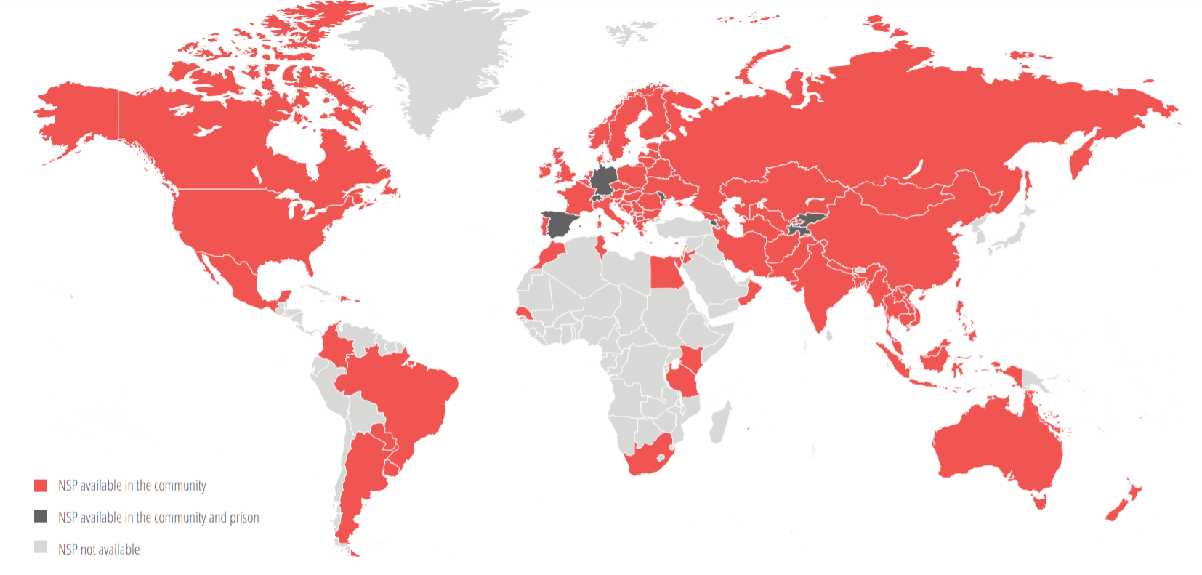
Needle & syringe exchange
Availability of NSP (2016)
Data from: Stone, K (2016) The Global State of Harm Reduction. Harm Reduction International

Slide 13
Priorities for action
Enhanced routine surveillance of STIs (other than HIV and Hep C) among people who use drugs
Diversification of STI testing options for people who use drugs, to include community settings and self-testing
Tackling stigma towards people who use drugs among health care professionals (and policy makers)
Enhanced provision of needle and syringe exchange programs
Acknowledgement of human rights of people who use drugs

Slide 14
Thank
you

